Slide 1


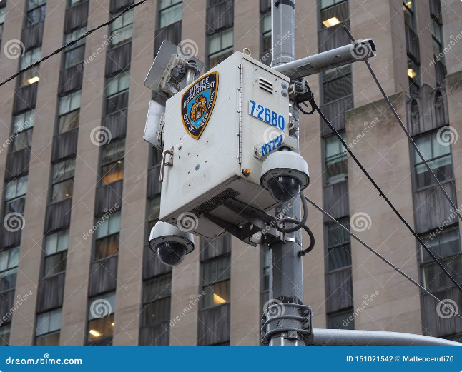
Harnessing AI for Smarter CCTV: Enhancing Crime Prevention
Discover how AI-powered CCTV is transforming the landscape of crime prevention, unlocking a new era of enhanced security and proactive responses.

Slide 3

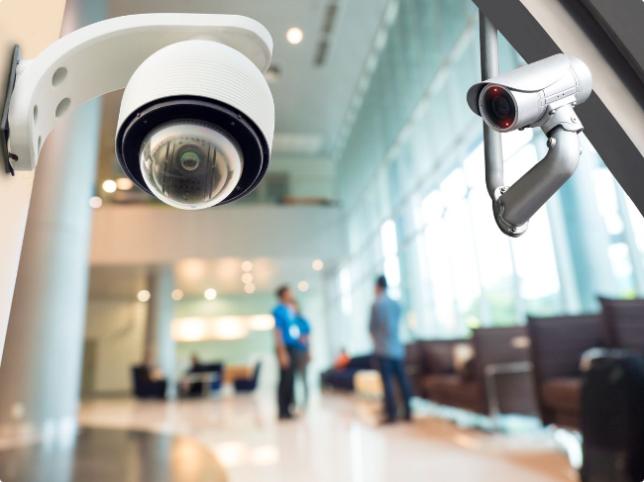
Understanding the Limitations of Traditional CCTV Systems
1
Reactive Approach
2
Human Reliance
Conventional CCTV systems primarily record and document events, lacking the ability to proactively identify and prevent criminal activities.
Monitoring CCTV footage is often a labor-intensive task, heavily dependent on human attention, which can lead to missed opportunities.
3
Lack of Contextual Analysis
Traditional CCTV systems struggle to make sense of complex, real-world scenarios, limiting their effectiveness in dynamic environments.

Slide 4
How AI-Enhanced CCTV Can Improve Crime Prevention
Automated Monitoring
Advanced Analytics
Improved Responsiveness
AI-powered CCTV systems can continuously analyze footage, identifying suspicious behaviors and alerting authorities in real-time.
AI algorithms can extract deeper insights from CCTV data, enabling predictive analytics and anomaly detection to uncover emerging threats.
By integrating AI-enhanced CCTV with law enforcement workflows, authorities can expedite investigation and intervention processes.

Slide 5


Facial Recognition and Object Detection Capabilities
Facial Recognition
Object Detection
AI-enabled CCTV can accurately identify individuals, facilitating the tracking of suspects and the prevention of criminal activities.
Advanced computer vision techniques allow AI-enhanced CCTV to detect and classify objects, such as weapons or stolen goods, to alert authorities.
Behavior Analysis
Crowd Monitoring
AI algorithms can analyze body language, movements, and other behavioral cues to identify suspicious activities and potential threats.
AI-powered CCTV can monitor crowd dynamics, detecting overcrowding, congestion, and other safety concerns in real-time.

Slide 6
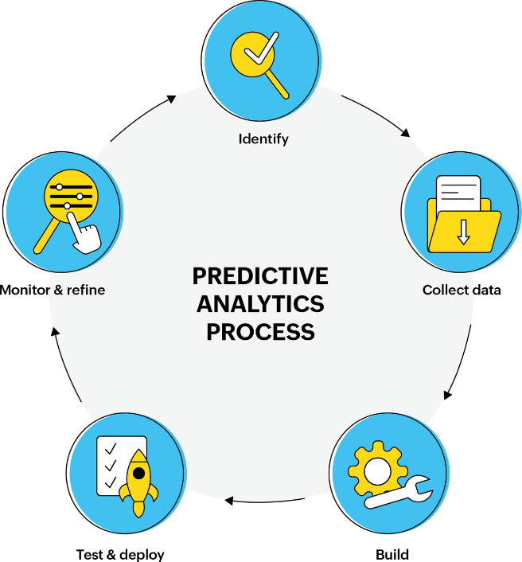
Predictive Analytics and Anomaly Detection
1
Pattern Recognition
AI systems can identify patterns in CCTV data, enabling the prediction of potential criminal incidents based on historical information.
2
Anomaly Detection
By continuously monitoring CCTV footage, AI algorithms can quickly detect and flag anomalous activities, triggering immediate response from authorities.
3
Data-Driven Insights
AI-enhanced CCTV can provide valuable data-driven insights to law enforcement, informing strategic decision-making and resource allocation.

Slide 7

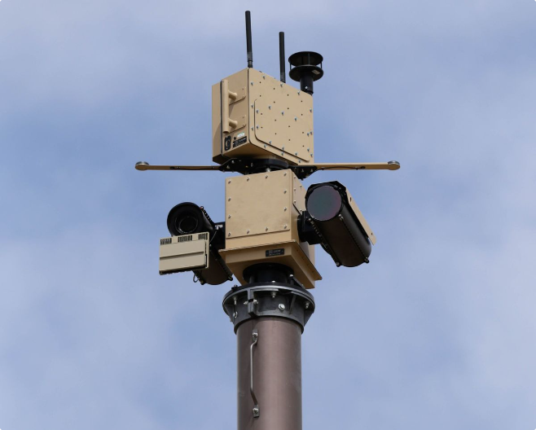



Integrating AI-Enhanced CCTV with Law Enforcement Workflows
Automated Alerts
AI-powered CCTV systems can instantly notify law enforcement of potential threats, enabling a more proactive and coordinated response.
Streamlined Investigations
By providing relevant video evidence and suspect information, AI-enhanced CCTV can expedite investigative processes and improve case closure rates.
Improved Resource Allocation
Data-driven insights from AI-enabled CCTV can help law enforcement agencies optimize their deployment of personnel and resources.

Slide 8

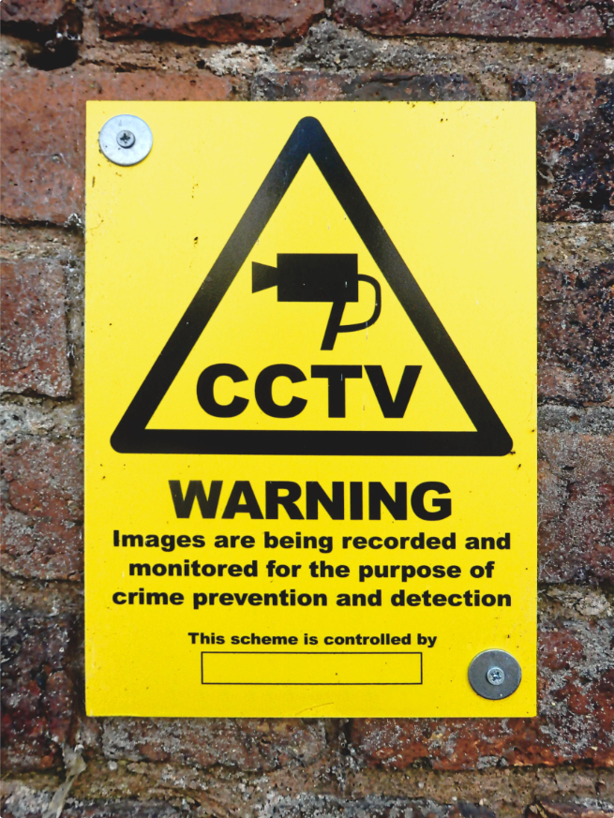
Addressing Privacy Concerns and Ethical Considerations
1
Transparency and Accountability
2
Data Protection and Consent
Establishing clear policies and guidelines for the use of AI-enhanced CCTV, with oversight and public engagement, can help address privacy concerns.
Robust data privacy measures, such as anonymization and user consent protocols, are crucial to ensure the ethical deployment of AI-powered CCTV.
3
Biases and Fairness
Continuous monitoring and auditing of AI systems are necessary to identify and mitigate potential biases that could lead to discriminatory practices.

Slide 9

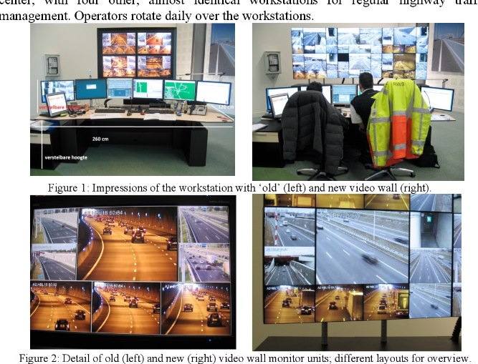



Case Studies: Successful Implementations of AI-Enhanced CCTV
Smart City Surveillance
A major metropolitan area deployed AI-powered CCTV, leading to a 25% reduction in crime rates and a 20% increase in case closure.
Airport Security Enhancement
An international airport integrated AI-enhanced CCTV, improving passenger flow and detecting potential security threats with a 95% accuracy rate.
Retail Loss Prevention
A large retail chain implemented AI-powered CCTV, resulting in a 35% decrease in theft and a 15% improvement in inventory management.

Slide 10


Challenges and Roadblocks in Adopting AI-Enhanced CCTV
Infrastructure Limitations
Upgrading legacy CCTV systems and ensuring reliable network connectivity can pose significant logistical and financial hurdles.
Data Privacy Regulations
Strict data privacy laws and public concerns over surveillance can slow the widespread adoption of AI-enhanced CCTV.
Algorithmic Bias
Ensuring the fairness and accuracy of AI algorithms used in CCTV systems is crucial to prevent discriminatory outcomes.
Public Acceptance
Gaining public trust and addressing concerns about the use of AI-powered CCTV for crime prevention is an ongoing challenge.

Slide 11

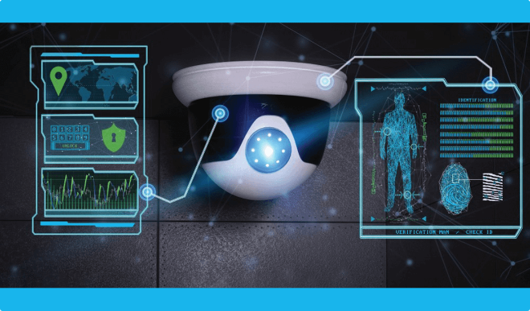
The Future of AI-Powered CCTV in Crime Prevention
Predictive Policing
Multimodal Integration
Advancements in AI and predictive analytics will enable CCTV systems to anticipate and prevent crimes before they occur.
The integration of AI-enhanced CCTV with other sensors and data sources will create a comprehensive security ecosystem for smarter crime prevention.
Ethical Governance
Continuous Innovation
Robust ethical frameworks and regulatory oversight will ensure the responsible and equitable deployment of AI-powered CCTV technologies.
Ongoing research and development in computer vision, deep learning, and edge computing will drive the evolution of AI-enhanced CCTV solutions.

Slide 12
Thank you

